Slide 1
Article Three-The Judicial Branch

Slide 2
The Power to Interpret laws is given to
The Supreme Court
9 Justices-1 Chief Justice, 8 associate justices
Appointed/chosen by President w/ Senate Approval
Serve for life-no political pressure - no bribes
Requirements-
NONE
$208,000, $217,000 annually

Slide 3
Supreme Court mostly hears cases from lower courts - State+Local courts
Dealing w/constitutional rights-
Violated or not- from Bill of Rights
Supreme Court decisions are-Final!?
Decisions Changed by-
Amendment or S.C. overturns old decision
Judicial Review-S.C. power to declare laws unconstitutional-ex. Segregated Schools

Slide 4
Chief Justice John Marshall increased power of S.C. and Federal government by giving court power of Judicial Review
The Supreme Court can influence public policy known as
Judicial Activism-Roe v. Wade-abortion case

Slide 5
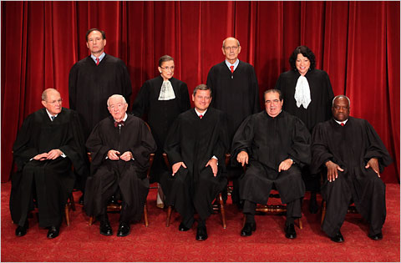

Slide 6
